Slide 1

Understanding Student Dropout Risks: A Data Science Approach
Analyzing Factors Influencing Student Retention
By: Umeokafor Chidiebere AgathaMary
Date: October 2024

Slide 2

Overview
Student dropout rates have significant implications for individuals and society.
Student dropout rates have significant implications for individuals and society. Understanding the underlying factors can help educators and policymakers create effective interventions.
In this presentation, we’ll explore the data-driven insights into why students leave school before graduation.

Slide 3
Objectives
Goals of the Presentation:
Identify key factors contributing to student dropouts.
Present data analysis methods used to uncover these factors.
Develop and optimize predictive models to forecast student dropout rates
Share actionable insights and recommendations to improve student retention and success

Slide 4
Data Collection
Sources of Data:
We gathered the data from the 3signet Google drive.
Mother's Qualification: The highest education level attained by the applicant's mother.
Father's Qualification: The highest education level attained by the applicant's father.
Mother's Occupation: The current occupation of the applicant's mother.
Father's Occupation: The current occupation of the applicant's father.
Admission Grade: The grade received during the admission process.
Displaced: Indicates whether the applicant is a displaced person.
Educational Special Needs: Indicates if the applicant has any educational special needs.
Debtor: Indicates if the applicant has any outstanding debts.
Tuition Fees Up to Date: Indicates if the applicant's tuition fees are current.
Data Description:
The data contains 4424 rows and 37 features and are describe as follows:
Marital status: Indicates the marital status of the individual (e.g., single, married).
Application mode: The method by which the application was submitted.
Application order: The sequence number of the application submitted.
Course: Identifies the specific course the applicant is applied for
Daytime/evening attendance: Indicates whether the applicant attends classes during the day or evening.
Previous qualification : The highest level of education/certifications attained prior to application.
Previous qualification (grade): The grade achieved in the previous qualification
Nationality: The nationality of the applicant.

Slide 5
Curricular Units 1st Sem (Without Evaluations): Number of curricular units without evaluations in the first semester.
Curricular Units 2nd Sem (Credited): Number of curricular units credited in the second semester.
Curricular Units 2nd Sem (Enrolled): Number of curricular units enrolled in for the second semester.
Curricular Units 2nd Sem (Evaluations): Number of evaluations for curricular units in the second semester.
Curricular Units 2nd Sem (Approved): Number of curricular units approved in the second semester.
Curricular Units 2nd Sem (Grade): Average grade for curricular units in the second semester, measured as a float.
Curricular Units 2nd Sem (Without Evaluations): Number of curricular units without evaluations in the second semester.
Unemployment Rate: The unemployment rate relevant to the demographic.
Inflation Rate: The inflation rate at the time of enrollment.
GDP: The gross domestic product at the time of enrollment, measured as a float.
Features Description continuation
Gender: The gender of the applicant.Scholarship Holder: Indicates if the applicant holds a scholarship.
Age at Enrollment: The age of the applicant at the time of enrollment.
International: Indicates if the applicant is an international student.
Curricular Units 1st Sem (Credited): Number of curricular units credited in the first semester.
Curricular Units 1st Sem (Enrolled): Number of curricular units enrolled in for the first semester.
Curricular Units 1st Sem (Evaluations): Number of evaluations for curricular units in the first semester.
Curricular Units 1st Sem (Approved): Number of curricular units approved in the first semester.
Curricular Units 1st Sem (Grade): Average grade for curricular units in the first semester, measured as a float.

Slide 6
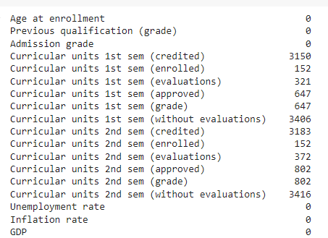
There were also outliers in the numerical columns but were not removed nor imputed since the students records varies
Data Transformation
One hot Encoder: was used to encode Nominal variables
Label Encoder: was used to encode Ordinal variables
Log Transformation: was used to transform skewed data
Standard scaler: was used to normalize numerical values to have a mean of 0 .
Feature Engineering
To improve the model’s accuracy, some features were engineered. These include:
Data Preparation
Data Cleaning
The data contained some missing values in the Curricular units 1st and 2nd semesters columns and also there were no records in the academic records for students who registered for Course 171. In order to avoid wrong analysis, the columns were removed.

Slide 7
Analysis Techniques
The problem is a classification problem and different types of models were used which includes:
Logistic Regression which is easy to implement but cannot handle complex patterns
Traditional models which are more of accuracy focused algorithm and can capture more complex patterns to provide the best accuracy. They are the Random Forest Classifier, Decision Tree Classifier, Support Vector Machines, Xgboost Classifier.
Deep Learning models with Pytorch.
Metrics
To see how the models perform, we used four different metrics:
Precision: The ratio of the True positive and the sum of the true positive predicted and the false negatives predicted
Recall: The ratio of the True positive and the sum of the true positive predicted and the false negatives predicted
F1 score: The harmonic mean of precision and recall.
Roc Auc Score: measures the area under the ROC curve, which plots the true positive rate (sensitivity) against the false positive rate (1 - specificity) at different classification thresholds.
Technologies Used
Python, numpy, pandas, scikit-learn, pytorch, matplotlib, seaborn, plotly

Slide 8
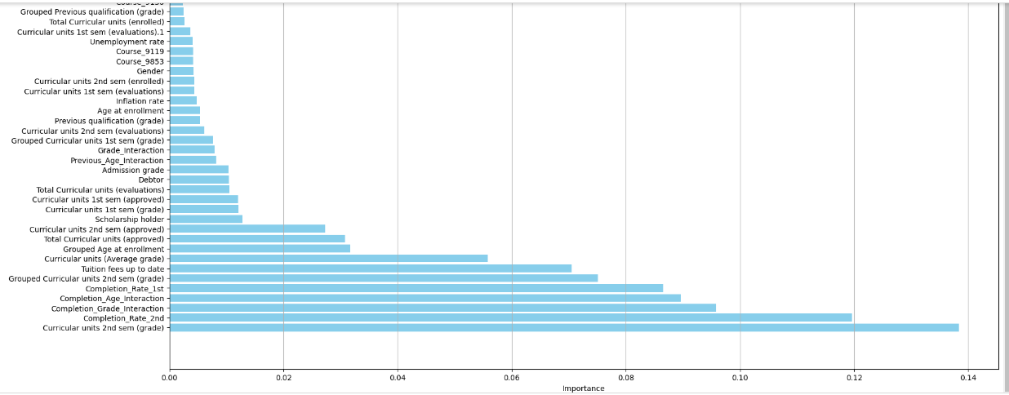
FINDINGS
The diagrams in this slides and next 3 slides show the most important features from tree based the models used

Slide 9
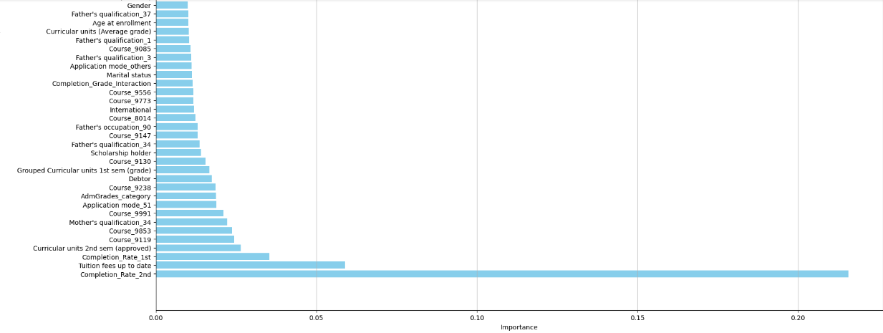
The diagram shows the most important features

Slide 10
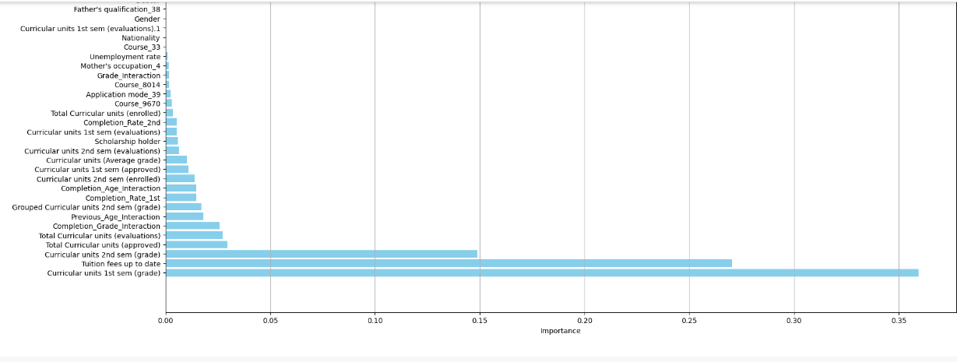
The diagram shows the most important features
The diagram shows the most important features

Slide 11
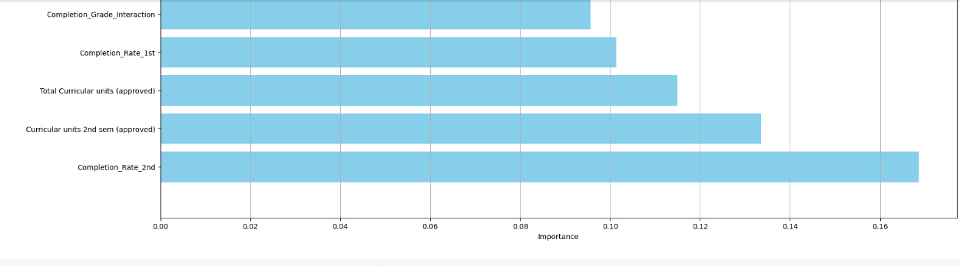
The diagram shows the most important features

Slide 12
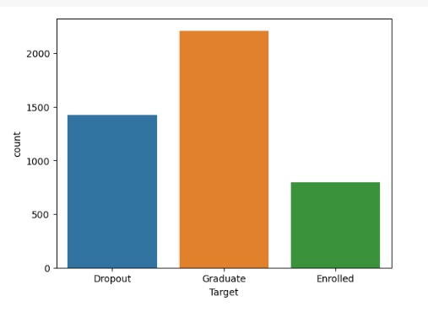

Slide 13
Conclusions
The Project aimed to identify students at risk of dropping out
Various machine learning classifiers were used to tackle the binary classification task of dropout prediction. Of the models trained, the deep learning mode had the highest impact on performance for the task of dropout prediction.
Understanding the factors leading to student dropouts is essential for developing effective strategies to retain students."
By leveraging data-driven insights, schools can implement targeted interventions that support students and improve graduation rates."

Slide 14

THANK YOU
I’d love to hear your thoughts and answer any questions you may have."

